Slide 1
ST662 – Topics in Data Analytics Project 4: Firearms Background Checks
Naveen Ramprasad
Abhishek Acharya
Harsha Teja Nageshwaran
Karthikeyan Sundaram

Slide 2
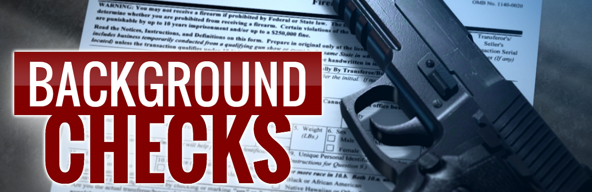

PROBLEM STATEMENT
Analyze the rate of change in total Firearms Background checks over time across different states in the United States

Slide 3

AGENDA
Data overview
Data cleaning and manipulation
Exploratory data analysis
What does the future hold?
Key Insights and takeaway

Slide 4
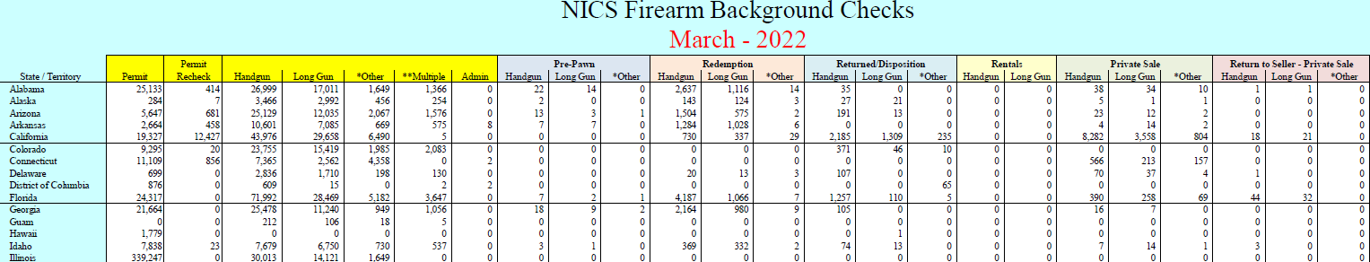
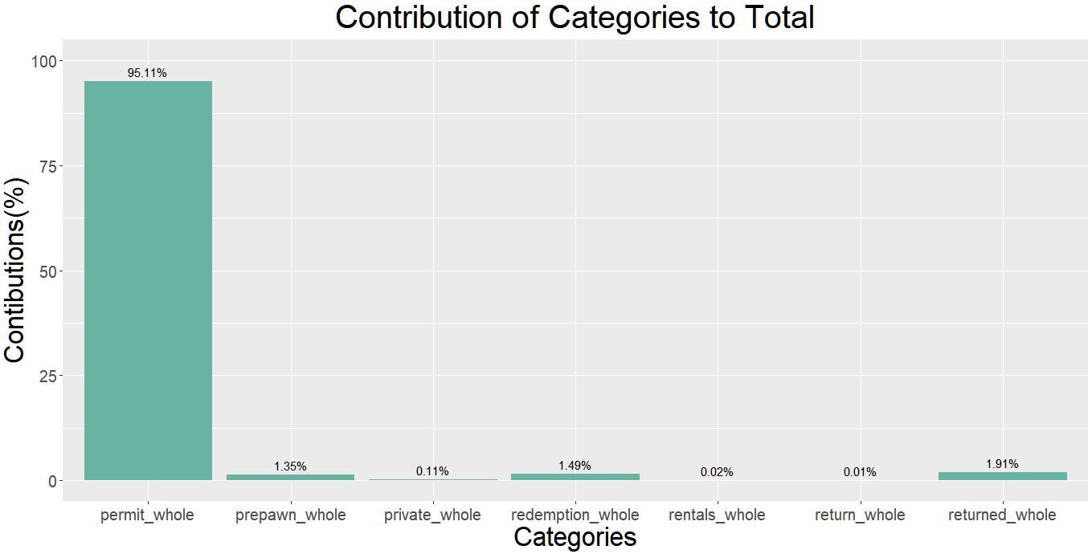
Data Overview
The dataset contains 15,400 rows and 25 columns spread across Nov 1998 – Mar 2022
Data contains monthly total checks for 55 states.
Collected from 7 different sources
Permit
Pre-Pawn
Redemption
Returned
Rentals
Private Sale
Return to Seller
Figure 1

Slide 5
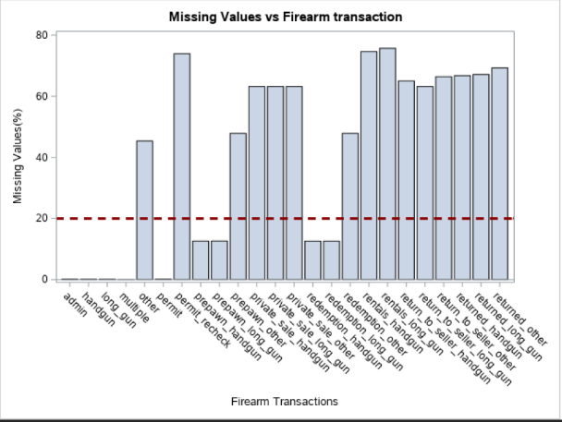
Data Handling
Data sanity checks:
Outliers identification in background checks
Duplicates
Gaps in time series
Missing values in the monthly data
Results:
No duplicate records were found
Transactions with more than 20% missing values are imputed with zeros, while others are imputed with the median. ​
Time series data is consistent without gaps
Figure 2

Slide 6
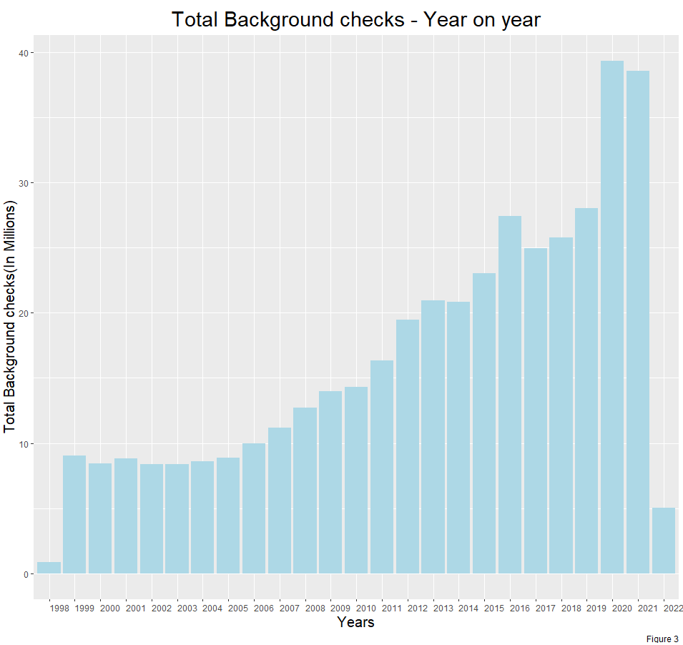
Exploratory Data Analysis
1. Total Background Checks Over Time - Yearly
Steady growth in the number of background checks post 2006
Disproportionate spikes in checks for the years 2016 and 2020
1998 and 2022 consist of data for just 3 months
Unexpected decrease in total background checks in 2021

Slide 7
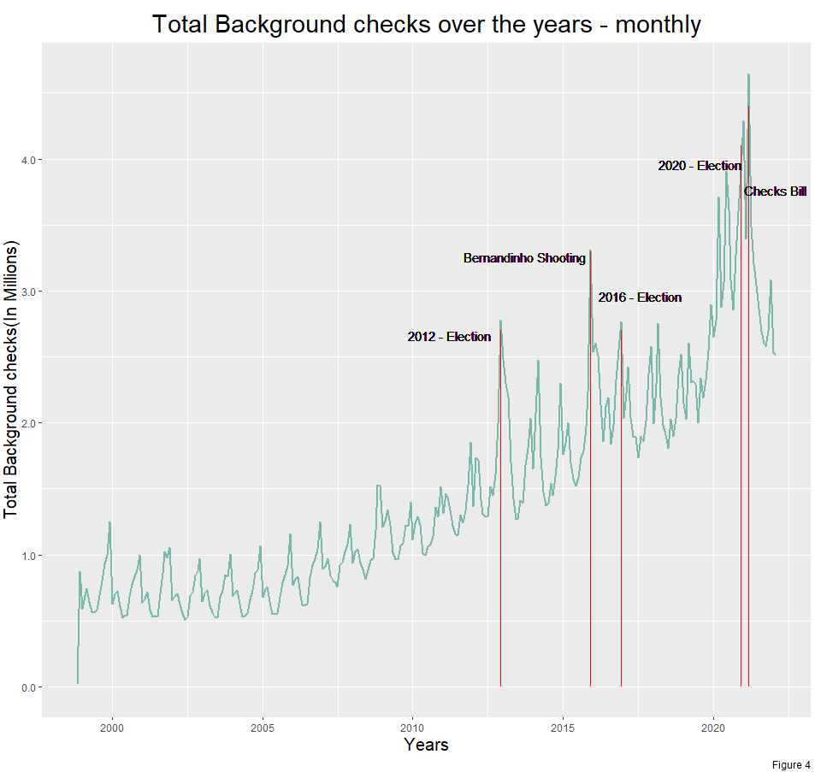
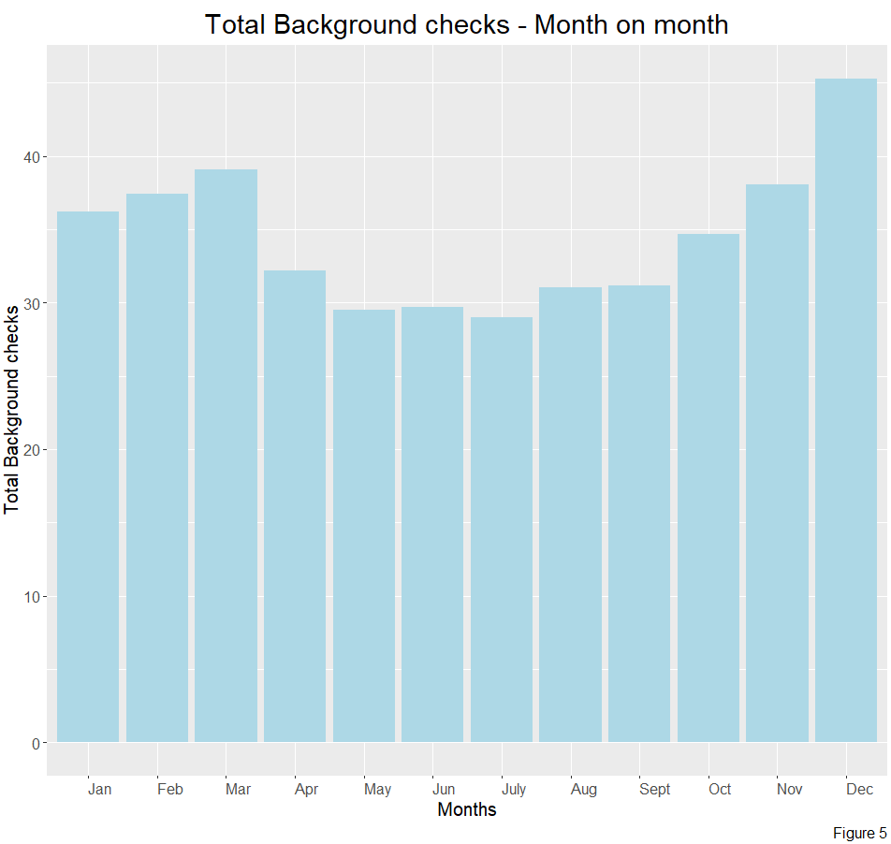
Exploratory Data Analysis
2. Total Background Checks Over Time - Monthly
Seasonality is observed with higher number of checks in the beginning and end of the year
Total checks trending upwards by years
Unexpected growth in number of checks during unforeseen events

Slide 8
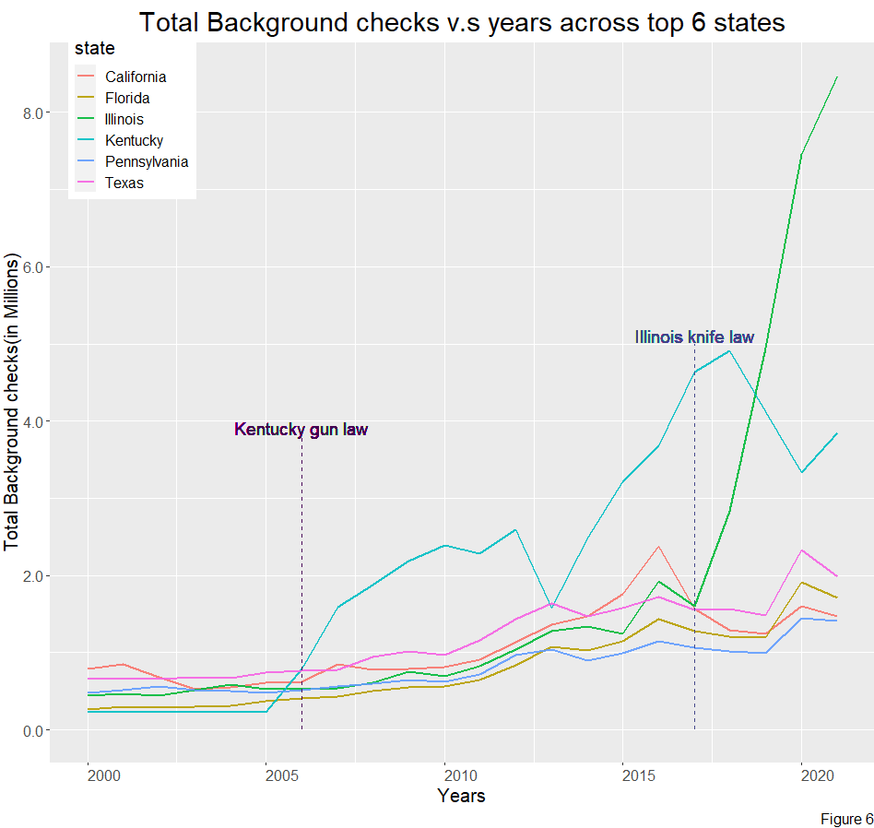
Exploratory Data Analysis
3. State-level Analysis – Top 6 States
All states have a gradual rise in number of background checks over the years except Illinois and Kentucky.
Kentucky sees inconsistent rise and fall in number of background checks post 2005
Illinois sees a steep rise in checks post 2016
Inter-state laws have an effect on Rate of Change in background checks

Slide 9
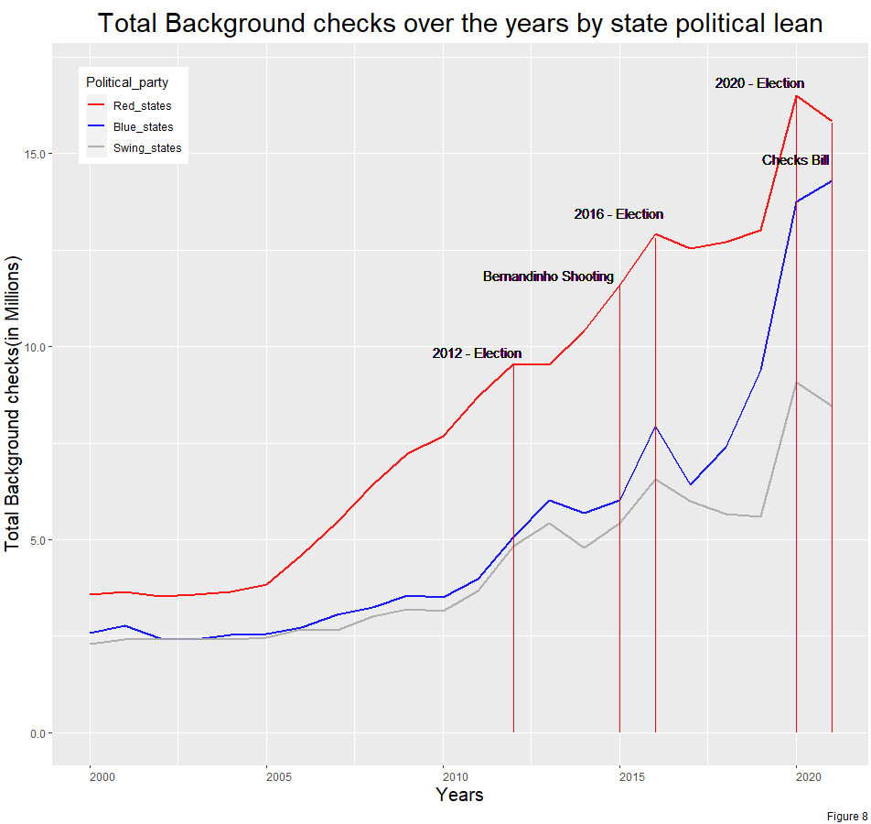
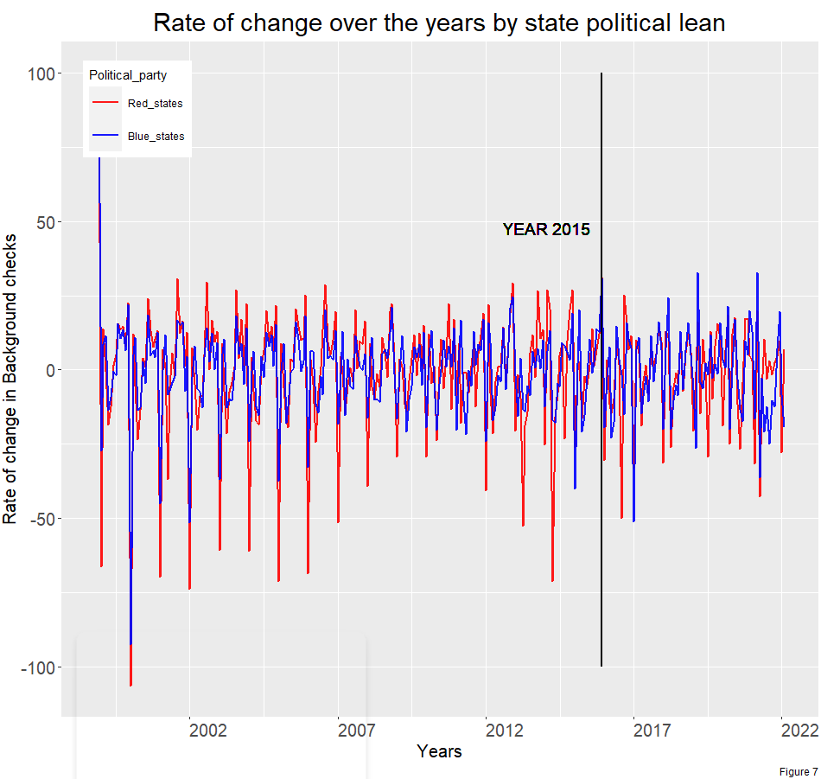
Exploratory Data Analysis
4. Political Intervention on the Background Checks
Red states have significantly higher background checks than blue states
Unforeseen events result in greater volatility in blue states than red
Steeper slope for red states over the years 2005-2015 and for blue states over 2015-2020

Slide 10
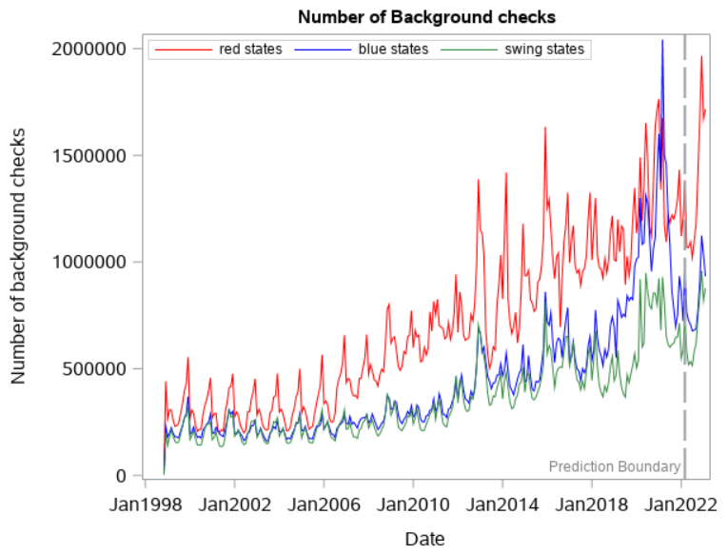
What does the future hold?
5. Expected Impact of Background Checks Bill
Forecast uses Holt-Winters model for multiplicative decomposition
Expect further decrease in number of checks until end of the year
Expect rise in checks by the end of the year due to seasonal pattern
The number of background checks in red states is likely to be higher than in blue states.
Figure 9

Slide 11
Key Insights
Increasing trend and seasonality pattern observed over time
Rate of Change in Total Background Checks over Time is affected by various factors such as:
Uncertain times and elections drive variability
Inter-state laws
Political intervention
Impact of Enhanced Background Checks law on the future trend:
Decreasing trend overall
Red states are expected to have higher checks than Blue and Swing states

Slide 12
Thank You!

Slide 13
Appendix

Slide 14
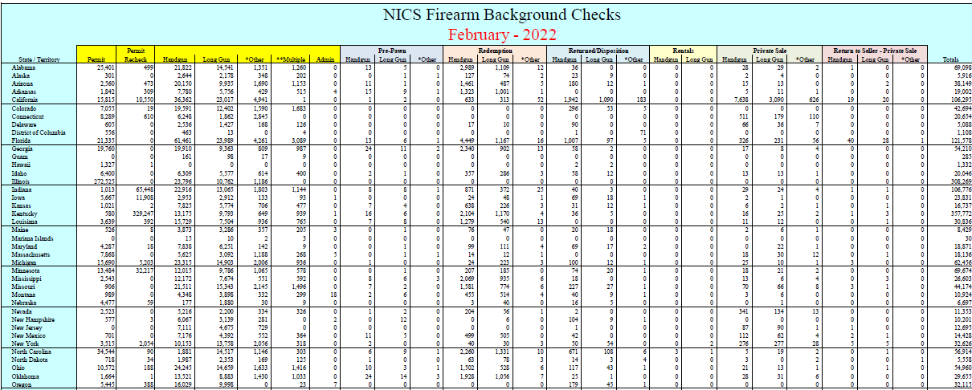
Data Overview

